Slide 1



Slide 2
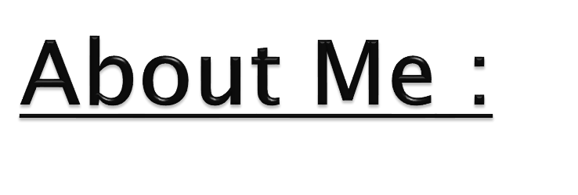

Hello there! I'm Vasundhara Gude, a passionate data enthusiast and recent graduate with a Master's in Mathematics. I am on a mission to apply my expertise and innovation to unlock valuable insights from data.
During my academic journey, I have honed my skills in statistical analysis, machine learning, and data visualization. My goal is to leverage my knowledge to contribute meaningfully to the world of data science and analytics.
I recently completed a data science certification, gaining expertise in Python, R, machine learning, and data manipulation. With hands-on experience and a focus on analytical thinking, I'm eager to apply these skills to real-world challenges. Let's connect and explore the exciting world of data science!

Slide 3

This Analysis aims to gain insights and understanding from the provided dataset, particularly focusing on the relationship between various features and the target variable, which is Salary. Specifically, the goals of this analysis include:
Describing the dataset and its features comprehensively.
Identifying any patterns or trends present in the data.
Exploring the relationships between independent and target variables (Salary).
Identifying any outliers or anomalies in the data.

Slide 4

The Aspiring Mind Employment Outcome 2015 (AMEO) dataset, released by Aspiring Minds, focuses on employment outcomes for engineering graduates.
It includes dependent variables such as Salary, Job Titles, and Job Locations, along with standardized scores in cognitive skills, technical skills, and personality skills.
With around 40 independent variables and 4000 data points, these variables encompass both continuous and categorical data.
The dataset also includes demographic features and unique identifiers for each candidate.

Slide 5

Dropping College and college city ID' -- they are same (around 1350 unique id’s)
Dropping columns which are unnecessary or may not be
known prior to receiving a job offer.
Changing the data type as required.
If a student hasn't opted/attempted an optional test, the same has been mentioned as -1. I will be replacing the same with 0.
On observing the data, some graduation years were mentioned as 0, replacing graduation year 0 with the modal graduation year.
DOL is before the DOJ date so deleted that data as it is
inconsistent.
We have many specializations .

Slide 6
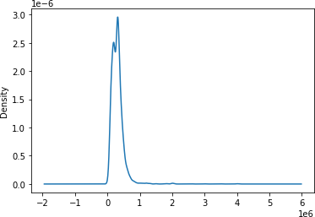
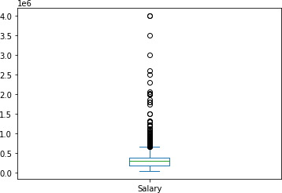
Salary ranges from 35k to 40L with higher density of 3L.
It is right skewed.
count 3998
min 35000
max 4000000
mean 307699
median 300000 var 4.52e+10 std 2.12e+05 skew 6.45
kurt 80.9

Slide 7

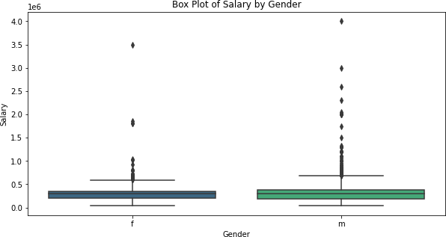
Yes, Male has higher median salary than Female.

Slide 8

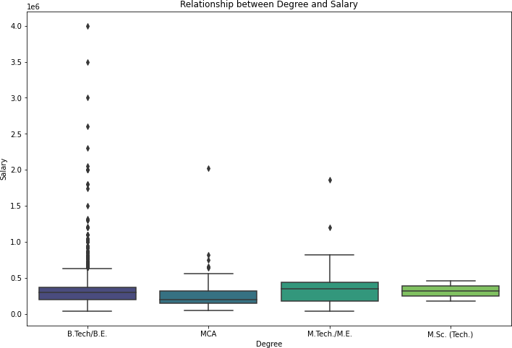
People having degree in B.E/B.Tech are having more packages/salary compared to other degrees.

Slide 9

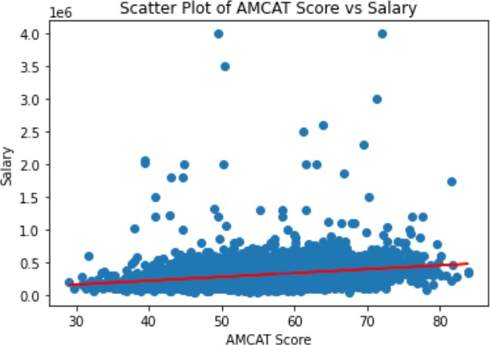
Pearson correlation coefficient: 0.25
P-value: 4.42e-59 .Since, P- Value equals to zero, we have enough evidence to reject H0 (Null Hypothesis).
We could see there is a correlation among AMCAT scores and salary. [r=0.25]

Slide 10
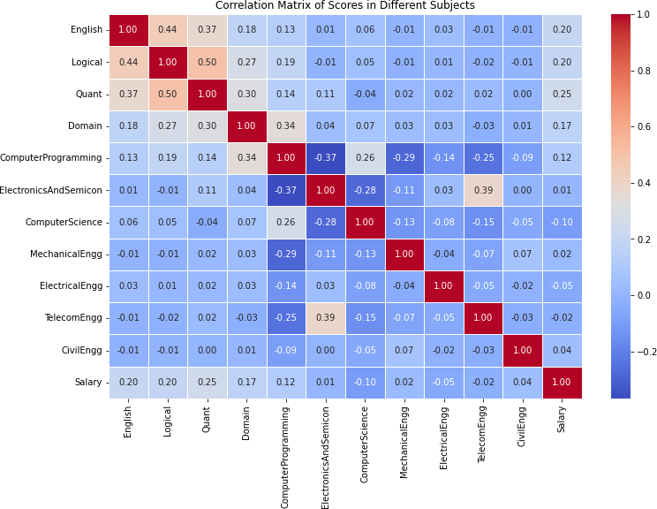
The Answer is YES!.
Some of these Subjects are positively correlated. • Hmm.
Forget rock-paper-scissors, it's English- Quant Logical in the AMCAT arena, and they're all working together!. They are more correlated with salary too.

Slide 11
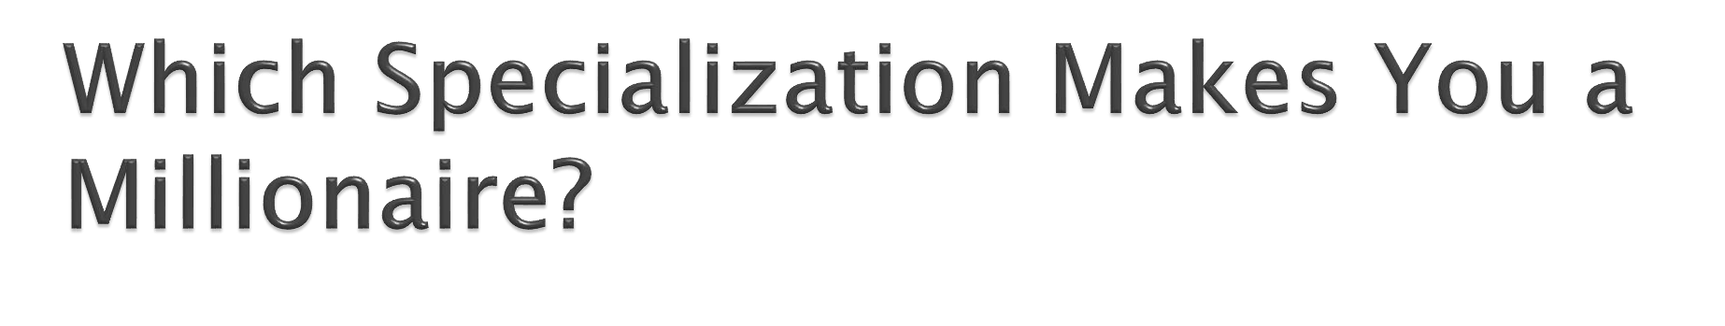
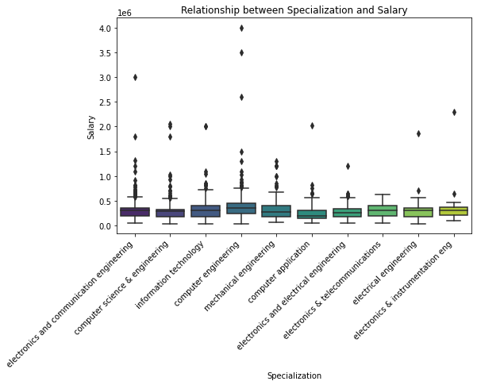
The plot twist nobody saw coming: Computer Engineers take home the salary crown.
Looks like the periodic table pays better than the binary code these days.

Slide 12

Geographical location alone does not strongly influence salary. Other factors such as gender, education background and skills play a significant role.
Graduation year does not have a direct impact on salary, indicating that experience and skills are more critical in determining earning potential.
Strong performances in English, Quantitative, and Logical sections of AMCAT positively affect salary, emphasizing the importance of these skills in the job market.
Subject choices, especially in engineering, show varying correlations with salary, highlighting the need for individuals to align their education with industry demands.
Traits alone do not have a decisive impact on salary, but individuals with certain traits may stand out as outliers in specific salary categories.
Claims about expected salaries should be based on current market trends, and individuals should consider gaining additional skills and experiences to enhance their earning potential.

Slide 13


